Slide 1
Pursuing Gender Equality
Presented by Pytorch Project Community

Slide 2
Team PyTorch
Rosemary Iwueze
&
Korede Adegboye

Slide 3
Outline
Introduction
Methodology
Results
Visualizations
Modelling
Discussion
Findings & Implications
Conclusion
Appendix

Slide 4
Introduction
Nature: Gender equality is important for an increase in human development worldwide
Problem: Females tend to be underrepresented in STEM industries
Questions
What is the current status of female graduates in STEM ?
What percentage of migrants are females ?
What will be the share females STEM graduates in 2022 ?

Slide 5
Methodology
Data Collection
World Bank Gender Statistics
United Nations Gender Inequality Index
Data Preprocessing
Exploratory Data Analysis
Data Visualization
Machine Learning

Slide 6
Results

Slide 7
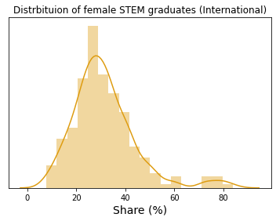
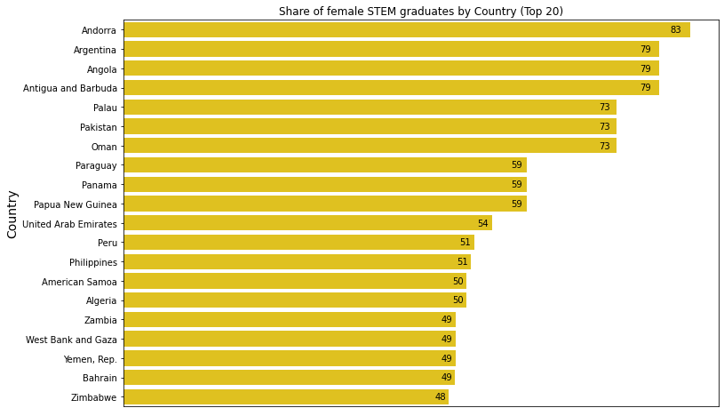
Female STEM Graduates

Slide 8
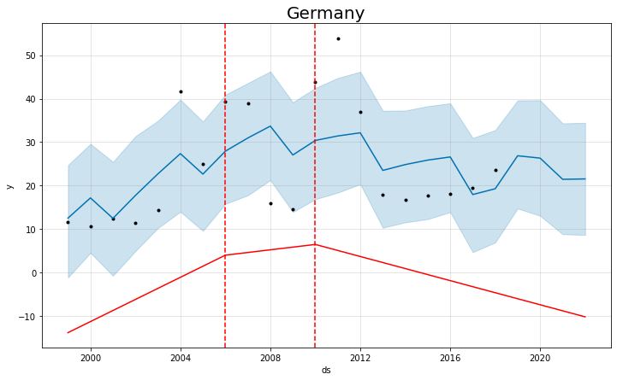
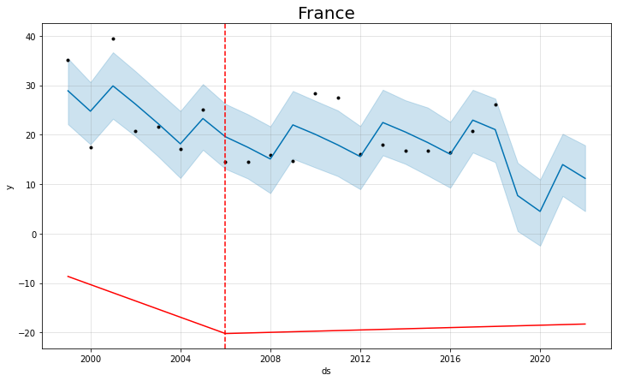
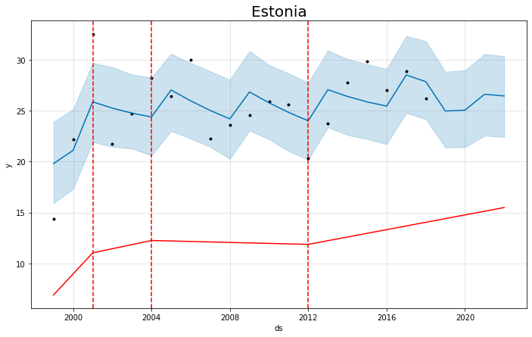
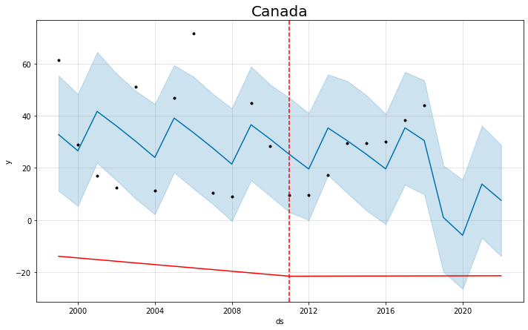
2022 Prediction of Female Share of STEM Graduates - Machine Learning

Slide 9
Female STEM Graduates – Findings & Implications
FINDINGS
Fewer than 4 of every 10 STEM graduates are girls
The top STEM contributors have a moderate share of female graduates
Some countries experience a spike in female STEM graduates
IMPLICATIONS
STEM development and thus human development needs more attention, in regards to including female perspectives
STEM research is at a loss
An increase in female STEM graduates could increase GDP

Slide 10
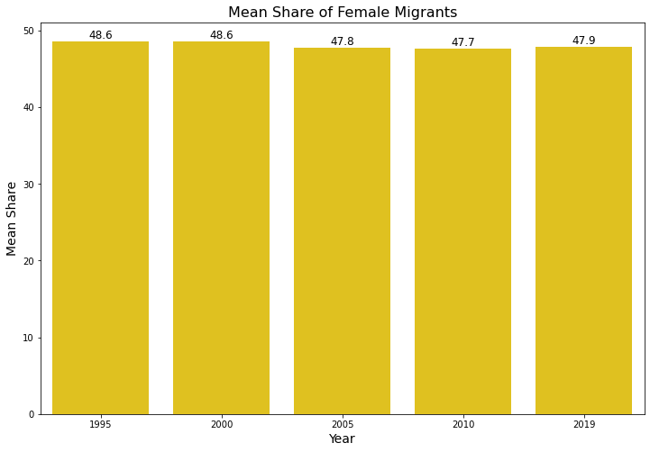
Share of Female Migrants

Slide 11
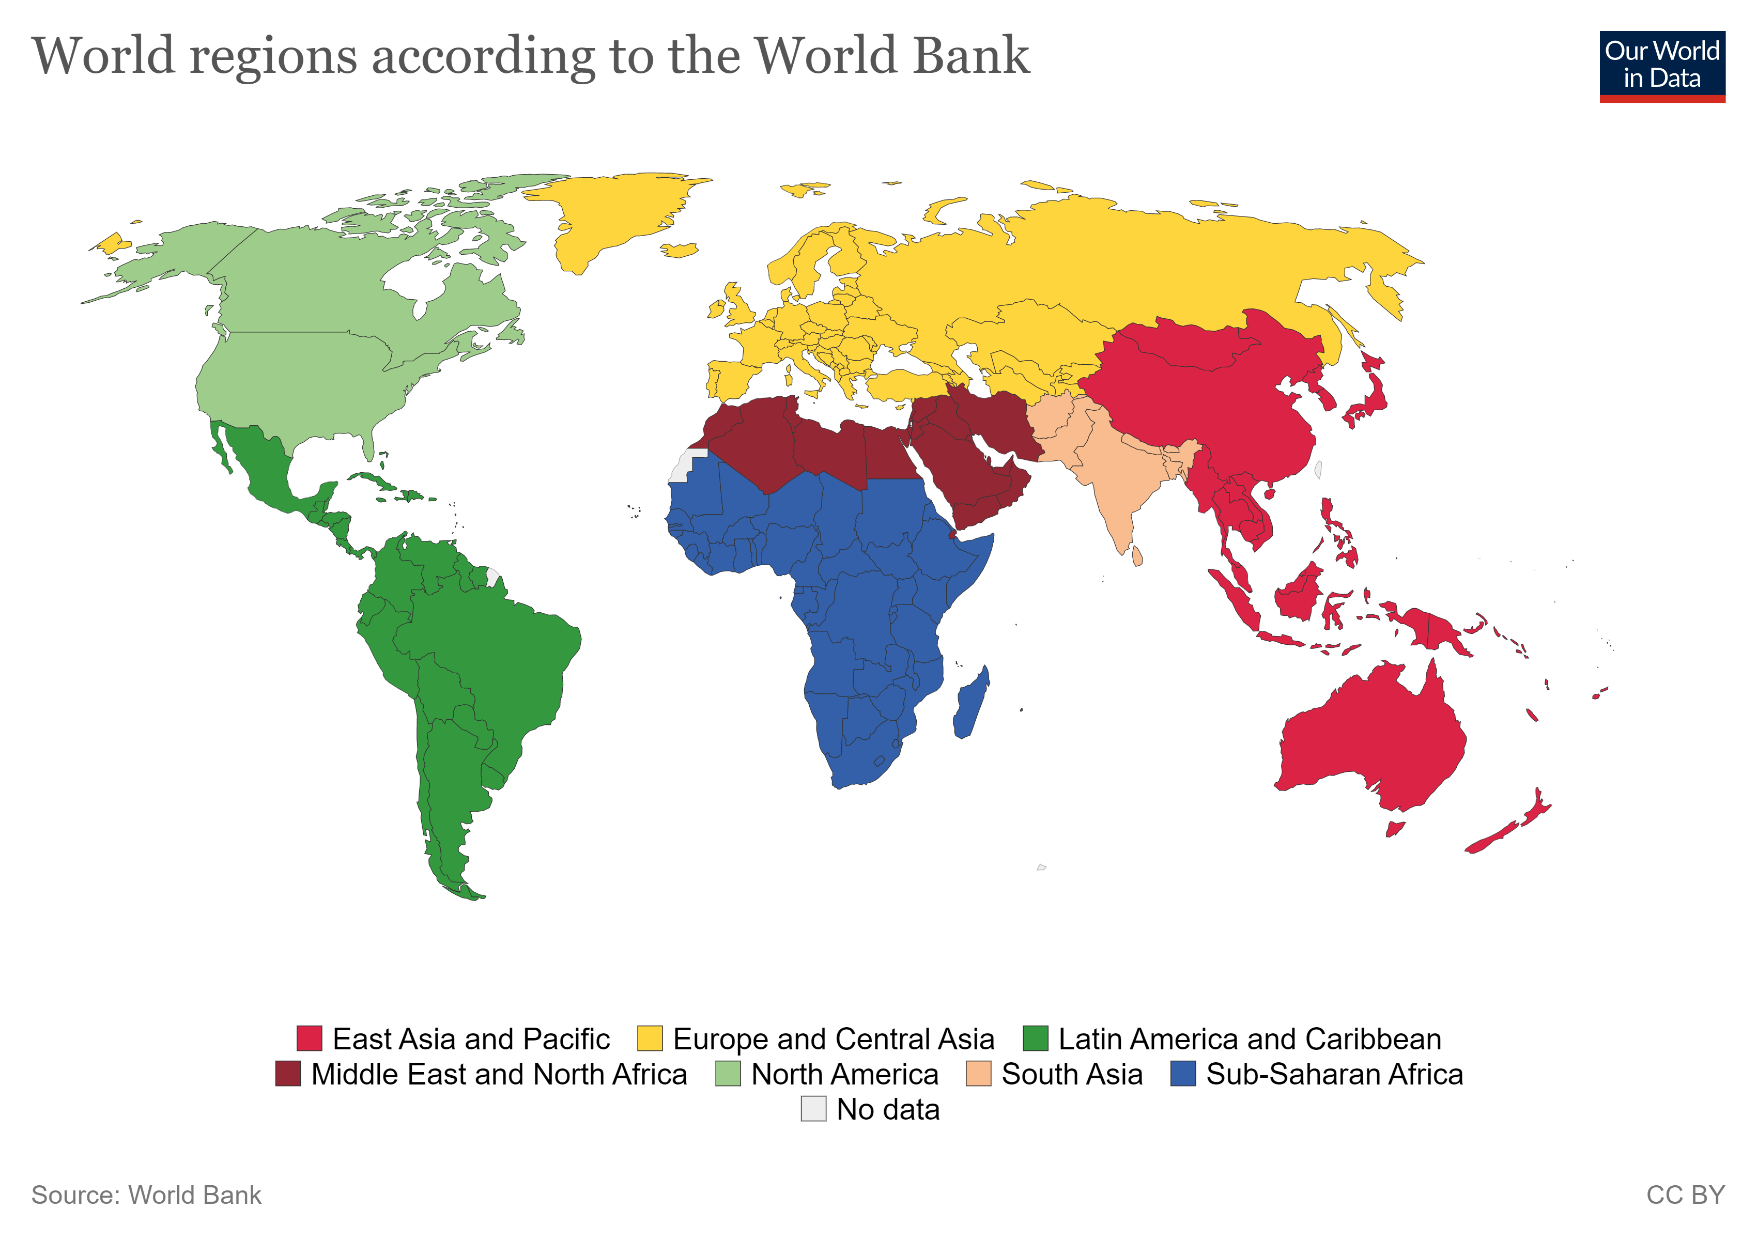
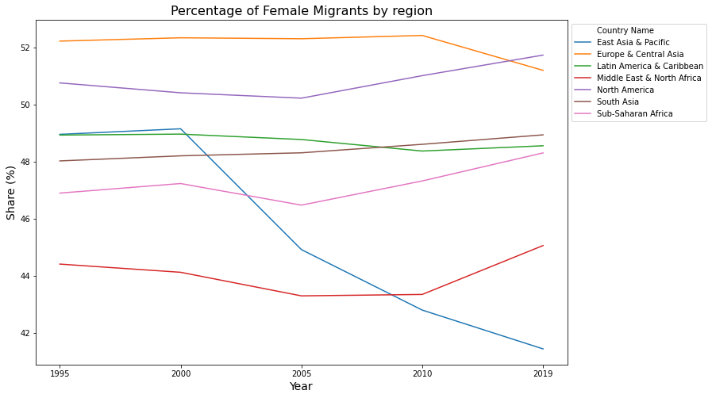
Share of Female Migrants by Region

Slide 12
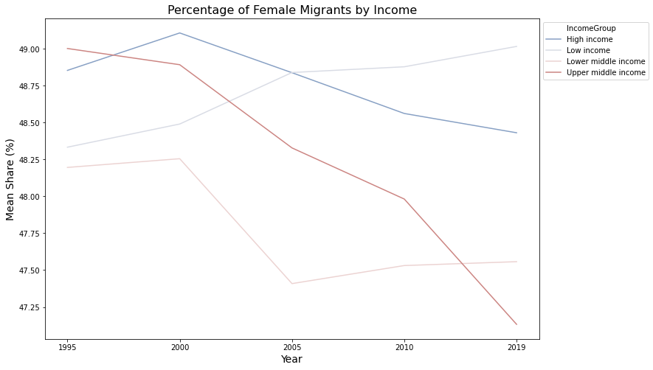
Share of Female Migrants by Income

Slide 13
Share of Female Migrants – Findings & Implications
FINDINGS
Nearly half of the world’s international migrants are women and girls
Gender composition of international migration varies significantly by region
Income helps explain shifting patterns of female migration
IMPLICATIONS
Promoting inclusion of migrants must include the female experiences, because female migrants are most susceptible to discrimination.
STEM opportunities directed for Low Income female migrants
Key actors such as North America and Europe & Central Asia are important for gender equality and thus human development

Slide 14
Discussion
Developed countries need to improve access to STEM programmes for female migrants
The work-life balance that STEM promotes, excludes the female perspective. Females of middle – high income tend not be interested in STEM programmes
Some countries should lower their acceptance rates for female migrants and provide an inclusive experience.
Developed countries can provide more opportunities for females. Empowering females, can have positive implications for their native countries.
Having females in the industry, will improve HDI and provide a better living for us all.
The share of STEM graduates ranges from decreasing, to gradually increasingly.

